Slide 1
MARVEL vs
DC Cinematic
Project 3 : Web APIs & Classification Kanakorn Kuchaiyanont (Gear)

Slide 2
Contents
01
02
Problem Statement
EDA & Cleaning the Data
03
04
Evaluate Model
Prediction

Slide 3
Problem Statement
#1
#2
#3
Finding the word that is the most likely to use in each subreddit.
Application to use for analysis text or message from chat or Email and classify them.
Examine the performance of various techniques employed for classification.

Slide 4
Steps of cleaning the data
Regular Expression
Remove Stop words
Lemmatizing
Removing number or special characters.
Remove the most common words in a language such as “a, an, the”.
Converting words with a list of words in the dictionary.

Slide 5
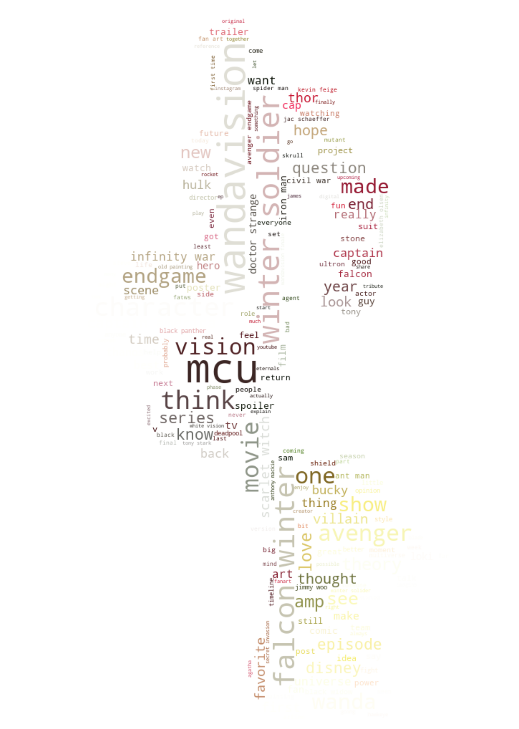
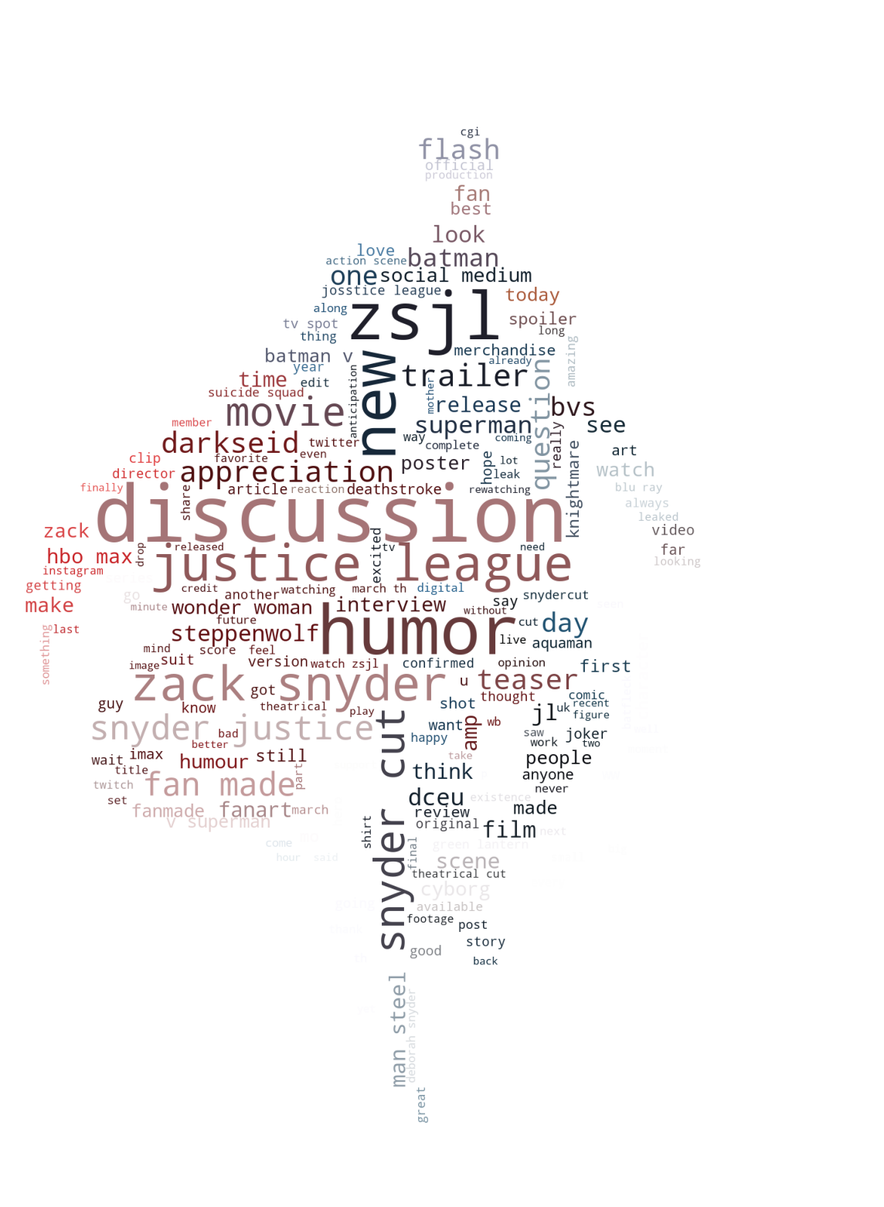
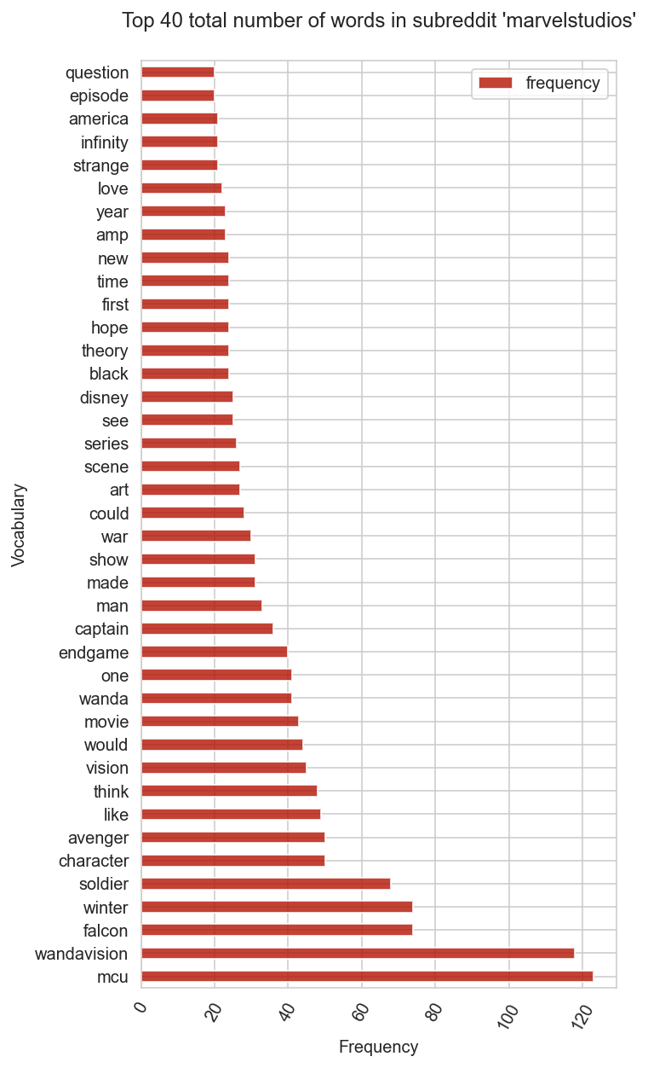
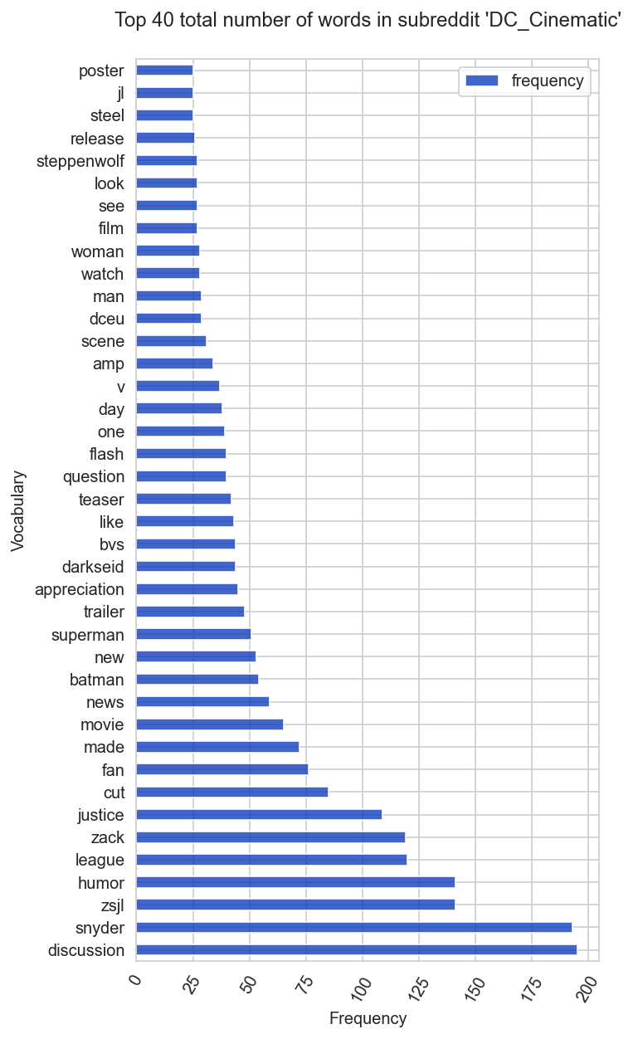
Exploratory Data Analysis
MARVEL (921 posts)
DC (951 posts)
Top 5 : Popular words of “marvelstudios”
Top 5 : Popular words of “DC_Cinematic”

Slide 6
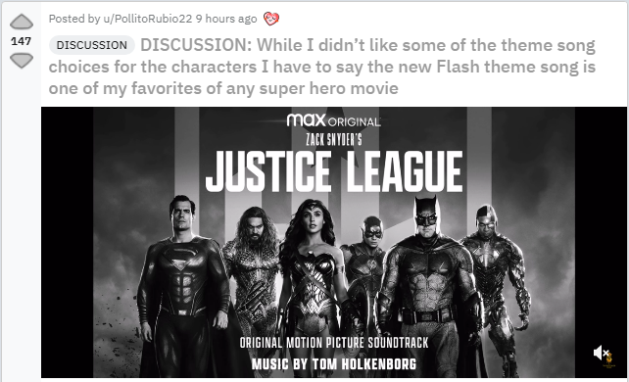
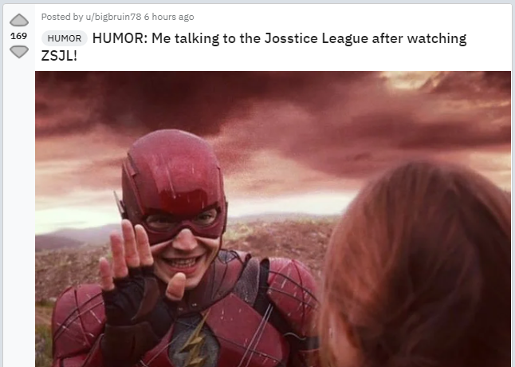
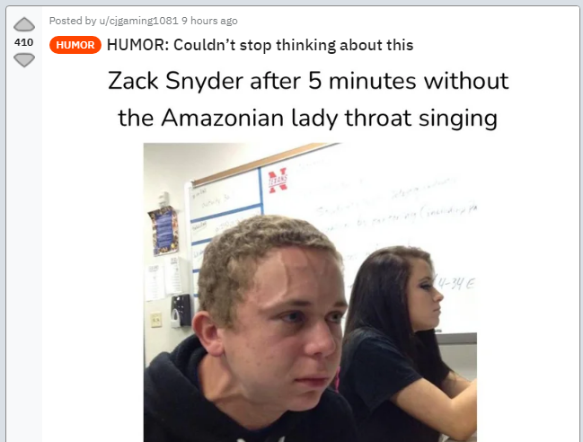

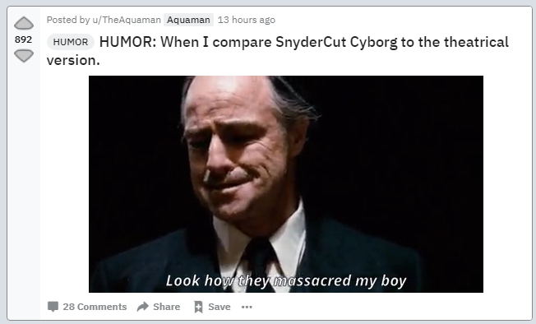
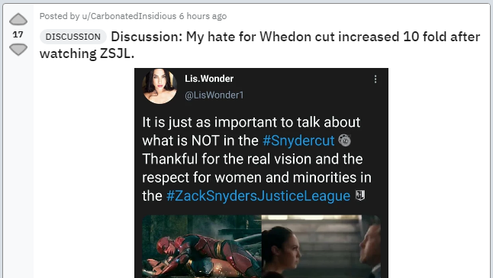
Exploratory Data Analysis (DC_Cinematic)

Slide 7







Model & Scoring
Model 1
Model 2
Model 3
Model 4
CountVectorizer + MultinomialNB
CountVectorizer + Logistic Regression
TF-IDF Vectorizer + MultinomialNB
TF-IDF Vectorizer + Logistic Regression
Training score : 0.9615
Testing score : 0.9337
Training score : 0.9764
Testing score : 0.9401
Training score : 0.9629
Testing score : 0.9316
Training score : 0.9736
Testing score : 0.9465

Slide 8
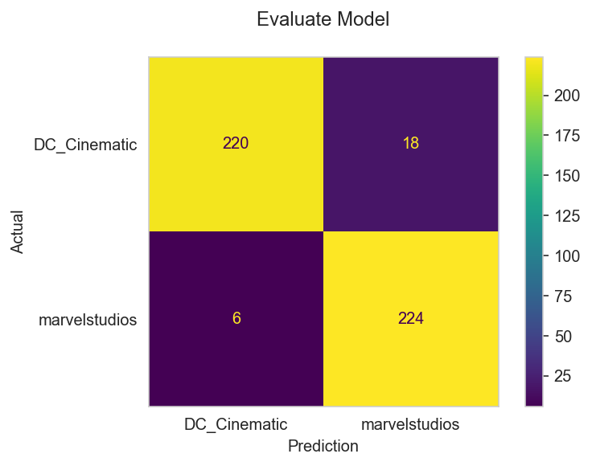
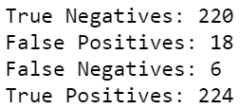
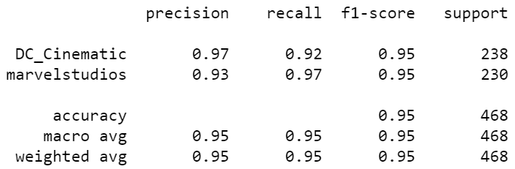
Evaluate Model 4 (TF-IDF + Logistic Regression)

Slide 9
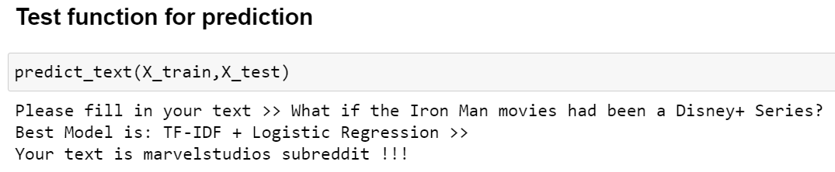
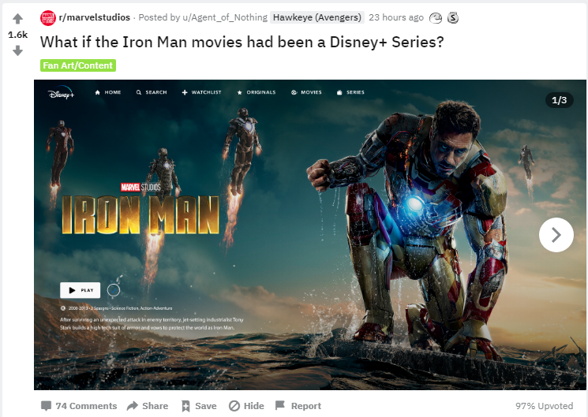
Prediction
Input
Cleaning text
Regex
Remove Stop words
Lemmatizing
Use the best model to predict and classify a new text
Title
GridSearchCV (4 Models)
CountVectorizer + MultinomialNB
CountVectorizer + Logistic Regression
TF-IDF Vectorizer + MultinomialNB
TF-IDF Vectorizer + Logistic Regression
<< Title
Model predicts subreddit from text
Example post from Reddit
Evaluate the best model from scoring
Copy title from post in Subreddit “marvelstudios” and predict.

Slide 10
Conclusion
Top 5 popular words of “marvelstudios” are “mcu, wandavision, falcon, winter and soldier. Top 5 of “DC_Cinematic” are “discussion, snyder, zsji, humor and league.
#1
From EDA, I found the abnormal popular words of “DC_Cinematic”. So in the step of gathering the data, we need to check the form of source and try to understand it.
#2
The model (TF-IDF) can predict with good accuracy to classify the subreddit.
#3
Can apply to use in real working to classify text from chat or Email.
#4

